Slide 1
FIT3143 Assignment 1
General Purpose Computing
On Graphics Processing Units
Presented by
32236247 - Low Jun Jie
31248403 - Pay Quan Bi

Slide 2
Peer-Reviewed Papers
GPU-based High-performance Computing for Radiation Therapy
Authors
Xun Jia
Peter Ziegenhein
Steve B Jiang
Presentor
Low Jun Jie
Using general-purpose computing on graphics processing units (GPGPU) to accelerate the ordinary kriging algorithm
Authors
E. Gutiérrez de Ravé
F.J. Jiménez-Hornero
A.B. Ariza-Villaverde
J.M. Gómez-López
Presentor
Pay Quan Bi

Slide 3
GPU-based High Performance Computing for Radiation Therapy

Slide 4

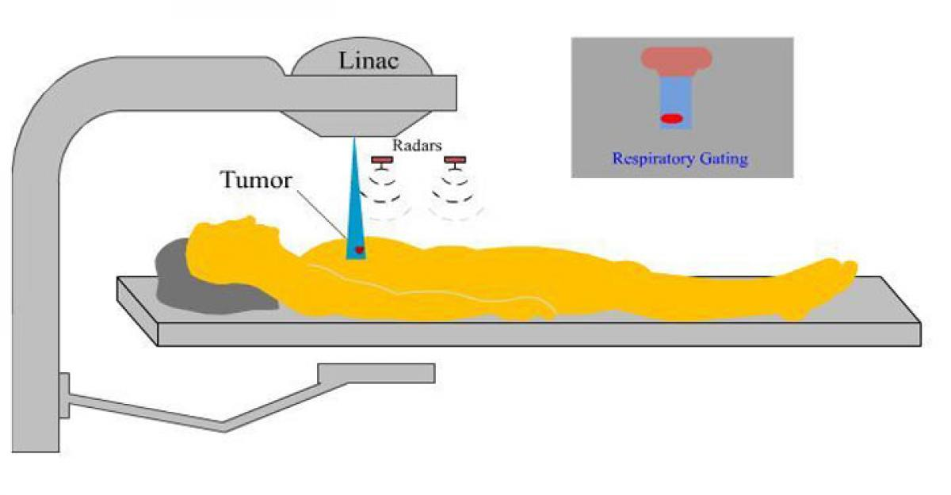

Background
Radiation Therapy
Radiation Therapy has had rapid development.
Especially,
Novel Technologies introduced into routine clinical practice.
Computationally Intensive Tasks

Slide 5


Background
What Technologies?

Slide 6
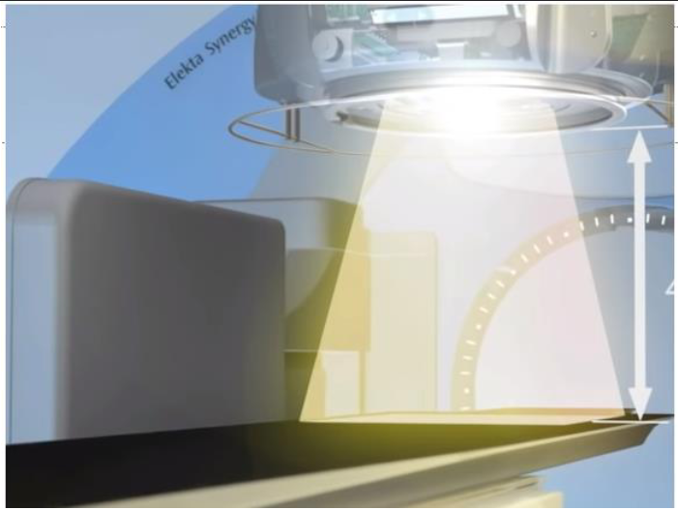
Background
Imaging-related Problems
Ray-Tracing
MC Photon Transport Simulations
Analytical CBCT Reconstruction
Iterative CBCT Reconstruction
Deformable Image Registration
What Technologies?

Slide 7

Background
Imaging-related Problems
Ray-Tracing
MC Photon Transport Simulations
Analytical CBCT Reconstruction
Iterative CBCT Reconstruction
Deformable Image Registration
What Technologies?
Treatment-related Problems
Non-MC Dose Calculation
MC Dose Calculation
Treatment Optimization
Gamma-Index Calculation
Notes:
MC - Monte Carlo
CBCT - Cone Beam CT Reconstructions

Slide 8


Problems with these new Shiny Technologies
They have LARGE datasets
It’s desired to have the problems solved
FAST
Traditional CPU method (especially serial) is too slow.
Moore’s Law (Moore 1965) shows that we will produce processors with ever increasing clock speed.
The bottleneck is reached due to limitations, and they are still unable to meet the near real time clinical demands of high throughput calculations.

Slide 9
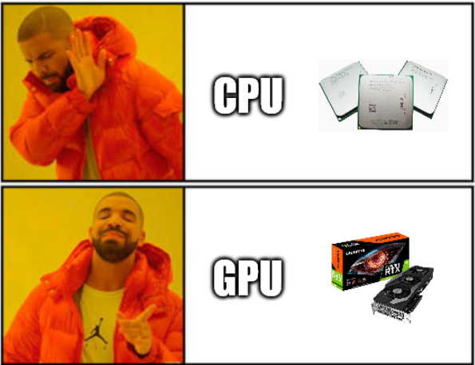
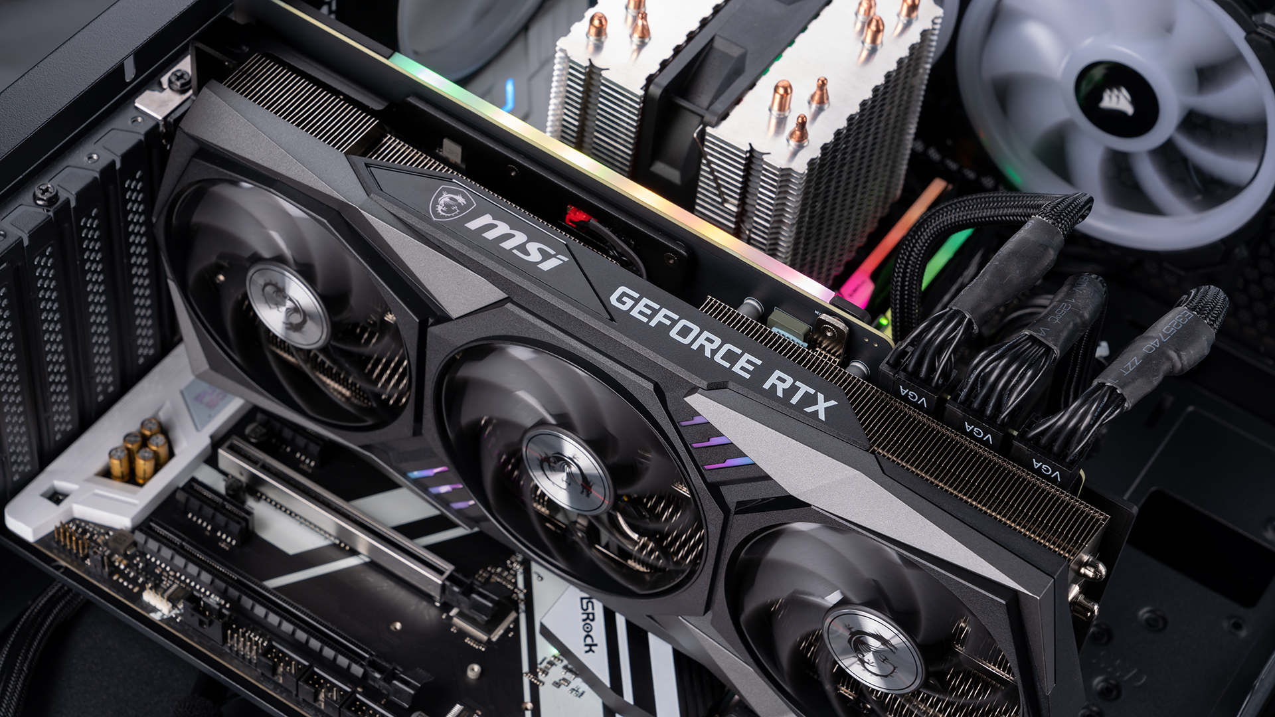
GPU
Graphics Processing Unit
Usually a card plugged in PCIe Bus
Termed ‘device’ in a computer system
Designed for Image Processing Computation
But recently used for other computation as well.
General Purpose computing on GPU (GPGPU)

Slide 10
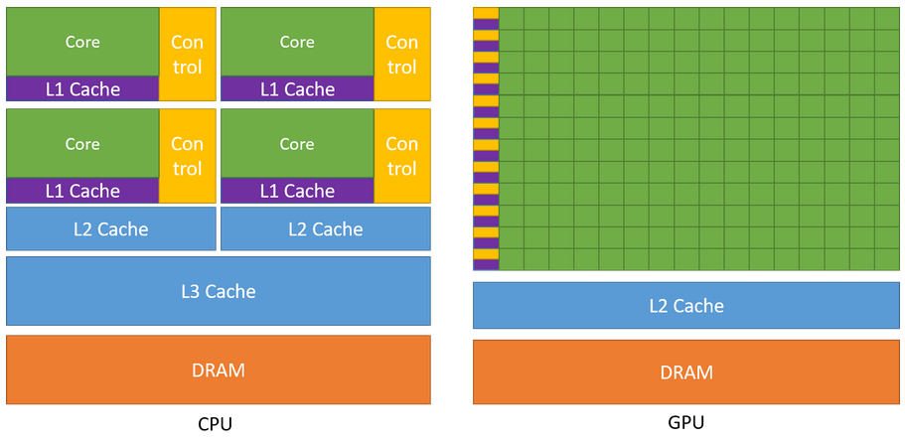
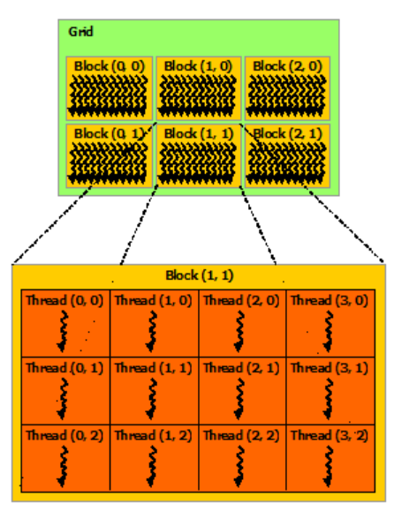

Hardware
GPU :
Loads of Processing Units (Stream Processors)
Lower Clock Speed than CPU, but sheer amount of PU results in
Cumulative Computational Power
Source : Nvidia CUDA Documentation

Slide 11
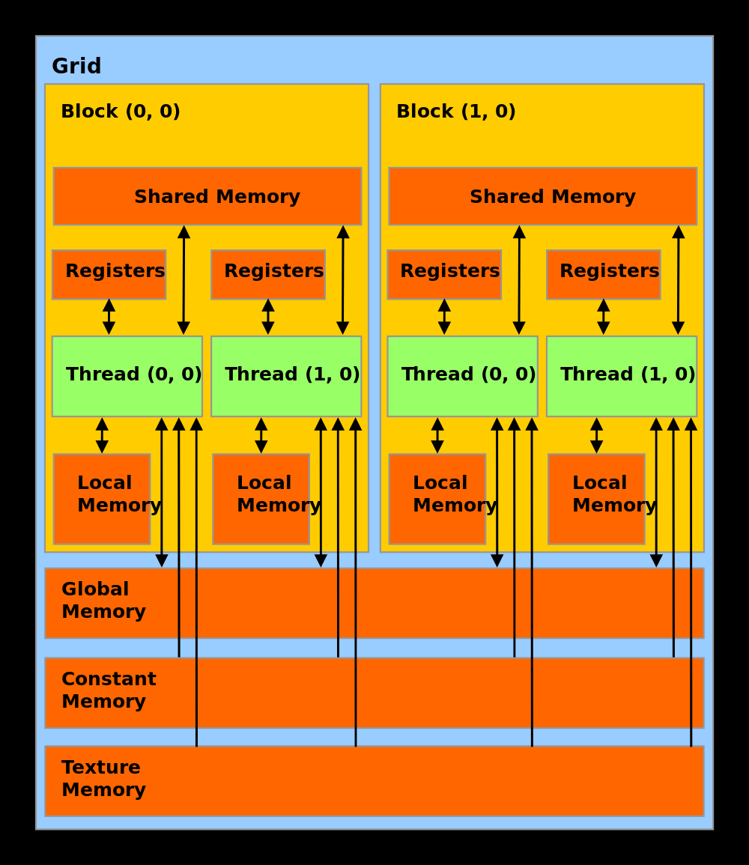
GPU Memory
GPU has multiple types of memory:
Global Memory (allocation of Arrays, Linear Memory and Constant Memory)
Shared memory
Registers
Proper use of such memories will result in increase in computational efficiency.
Bandwidth of Global Memory Low.
Arrays are bounded to textures, which are read-only memory that has multidimensional spatial locality cache.
Shared memory access is faster than global.
Source : https://gistbok.ucgis.org/bok-topics/graphics-processing-units-gpus

Slide 12
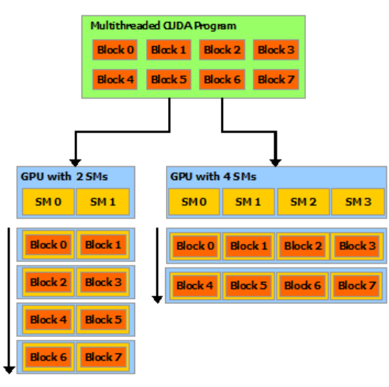
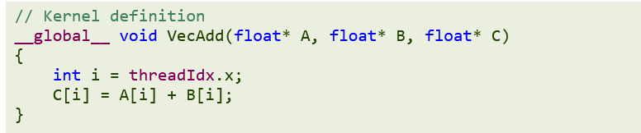
SIMD Programming Model
Single Instruction Multiple Data / Nvidia calls them Single Instruction Multiple Threads
GPU function called kernel launched in GPU with copies called a thread.
Source : Nvidia CUDA Documentation

Slide 13
SIMD Programming Model
Single Instruction Multiple Data / Nvidia calls them Single Instruction Multiple Threads
GPU function called kernel launched in GPU with copies called a thread.
Threads grouped into blocks, distributed to Multiprocessors.
Multiprocessors execute group of 32 threads (Warp)
In Warp, common instruction executed at a time.
Source : Nvidia CUDA Documentation

Slide 14


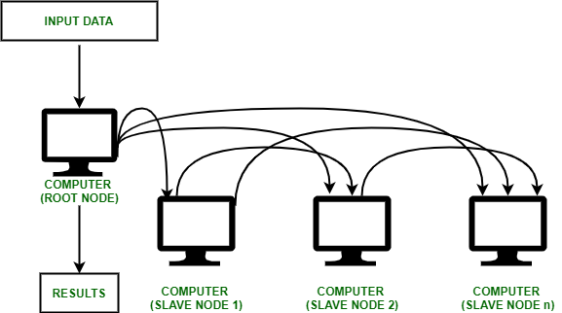
But Why GPU?
Radiation therapy problems are generally intermediate sized.
The communication overhead will make it less efficient in a Computing Cluster.

Slide 15
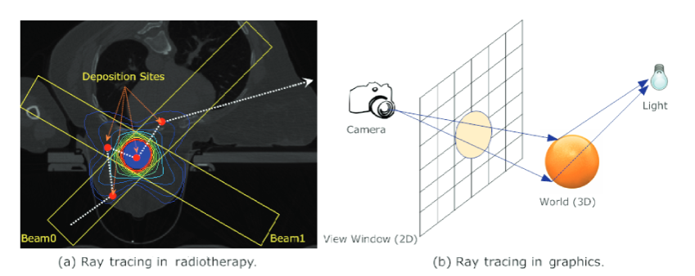
Radiation Therapy Problems
Imaging-related Problems
Ray-Tracing
MC Photon Transport Simulations
Analytical CBCT Reconstruction
Deformable Image Registration
Iterative CBCT Reconstruction
Iterative CBCT Reconstruction
https://dl.acm.org/doi/pdf/10.1145/2539036.2539038
Computation of line integral
g = ∫L dɭμ(x) of x-ray attenuation coefficient μ(x)
Treatment-related Problems
Treatment Optimization
Gamma-Index Calculation
Non-MC Dose Calculation
MC Dose Calculation
Power of GPU allows parallelizing to have each thread compute value of one line.
Non-MC Dose Calculation
MC Dose Calculation
Notes:
MC - Monte Carlo
CBCT - Cone Beam CT Reconstructions

Slide 16

Everything is Good, Just Switch GPU

Slide 17
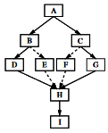
Issues with GPU
Thread Divergence Problem
SIMD model makes it so that only when all 32 threads in the warp have same execution path we can achieve full efficiency.
If there’s a branching path, the warp serializes each branch, and puts other threads on idle.
Xiao et al (2012) tried converting conditional statements in Ray Tracing algorithm into simple arithmetic and logic operations and achieved almost 2x speed up just with so.
Parallel Computation has Task and Data Parallelization (only data parallelization is good for SIMD)
This is similar to #Thread Divergence Problem, where due to SIMD, different GPU threads SHOULD be performing same operation, with different data.
https://dl.acm.org/doi/pdf/10.1109/MICRO.2006.20

Slide 18

Issues with GPU
Memory throughput limits the overall efficiency
Global Memory has lower bandwidth compared to other memory types.
Bandwidth of communication between CPU and GPU is much lower than in GPU.
Use of other memory spaces to improve access speeds and memory access locality.
(Podlozhnyuk 2007) successfully reduced the total memory visits to the slower Global Memory by utilizing GPU shared memory to store common pixel data in image convolution operation
Memory writing conflicts (Race conditions)
Multiple threads reading same memory is fine, writing concurrently isn’t fine.
Forced to compromise efficiency for serial writing.
Jia et al 2012a discusses that when multiple threads happen to deposit the dose to a voxel concurrently during MC dose calculation, the memory writing conflict occurs and it had to be serialized to obtain correct results.

Slide 19
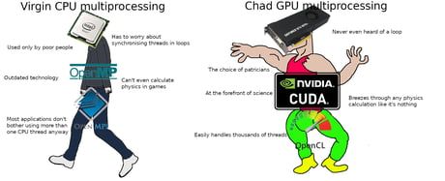
Conclusion
GPU has offered tremendous computational power to solve problems considered infeasible.
It has great potential for medical physics in radiotherapy and it is believed that GPU Computing will play a critical role in advancements of radiotherapy.

Slide 20
Using General-Purpose Computing on Graphics Processing Units (GPGPU) to Accelerate Ordinary Kriging Algorithm

Slide 21
Introduction
GeoScience and Geostatistics
Study of Earth
Statistical analysis on geographical or spatial datasets (attributes/variables in certain location)
Kriging Algorithm
Data of interested regions is not fully accessible
Spatial interpolation techniques as estimation
Largely used in GeoGraphic Information Systems (GIS) and statistical software
Applications of spatial data
Help environmental manager make effective and informed decision
Accurate data allow scientist to make justified interpretations
Used in various disciplines like agriculture and environmental control

Slide 22
Problem Statement - Kriging Algorithm
Computational Cost
Number of data points determines size of regions and accuracy of estimation
Scales with cube of number of data points
Slow simulation is bad for prediction purposes in making decision
Performance and Usage Coverage
Li and Heap (2011) shows that Kriging Algorithm is mostly used and performs better than other non-geostatistical approach
Kerry and Hawick (1998), O’Sullivan and Unwin (2002) has confirmed that Kriging has high computational cost

Slide 23
Solution Proposed & Related Works - Parallel Computing
Source of cost
Weight calculations for estimation is most time-consuming
Pesquer et. al. (2011) shows that during execution, 96.0% to 99.8% of the time is spent on weight calculations
Solutions
Tahmasebi et. al (2012) proposed parallel computational strategy as solution to geostatistical simulation
With small simulation grid, CPU is better than using master-slave architecture
Cheng et. al (2013) applied parallelism via OpenMP and GPU on universal kriging algorithm
Limited data sizes tested on parallelism of major steps in general Kriging Algorithm
Proposed solution is focusing on parallelizing matrix operations including matrix inversion using GPGPU

Slide 24
Related Works - GPU Architecture
GPU
More processing units
Large amount of memory
Large data transfer with high bandwidth
CUDA
Resulting simulation is combination of sequential and parallel codes
Support joint implementation of serial CPU and parallel GPU
Design
GPU is initially designed for video data processing
With gaming industry involved, GPU architecture advances in floating point calculations

Slide 25
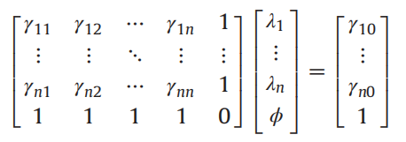
Methodology - Mathematical Equations
Kriging Interpolation
Generalized least-squares regression algorithms
Mainly used for estimating continuous attributes using weighted average of known values
Estimates is done using variogram (covariance) of observed values
Formulas
Z(x₀) = Σ λ_{i}Z(x_{i})
λ is weight and Σ λ_{i} = 1 for unbiased estimator
Using variogram (covariance), we can deduce that
γ(h) = ½E[{Z(x+h) - Z(x)}²] for all h
Estimates of weights, λ could be found by solving AV = B such that

Slide 26
Methodology - Parallel Algorithm
Matrix Addition
Single threaded algorithm has O(n²) time complexity
O(1) is achieved theoretically on gpu parallelism
Exceeding certain sizes, the time complexity is O(n)
Matrix multiplication
Classical multiplication implementation has O(n³) time complexity
Using parallelism with gpu, the time complexity is reduced to O(n²)
Matrix inversion
The initial time complexity is O(n²log n)
Using gpu for parallelism, time complexity of O(n) is achieved
Implementation
CUBLAS library with CUDA

Slide 27
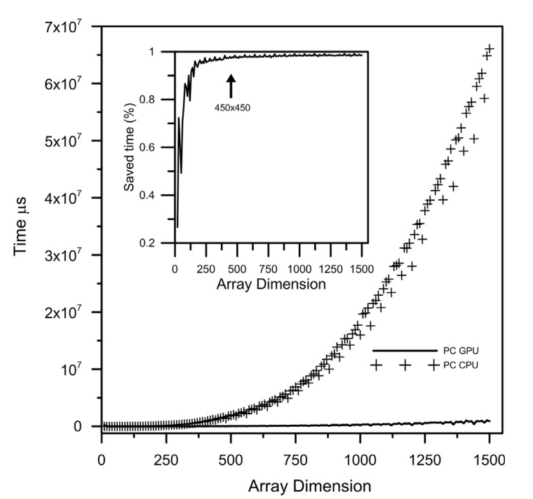
Results - Multiplication
Hardware Specifications
GPU GeForce 9500 (local) + GPU Tesla C1060 (server)
CPU AMD Athlon X2 4600 (local) + CPU Xeon 5600 (server)
Matrix Multiplication
Local
Difference between CPU and GPU is significant after dimensions of 450 x 450
The corresponding saved time is 97.3% .
At larger dimensions, cost of CPU increases rapidly
Server
Difference is only significant after dimensions of 1500 x 1500
The corresponding saved time is 99.8%
Experimental results show that growth of cpu is of order O(n³) while gpu is near to O(n log n)

Slide 28
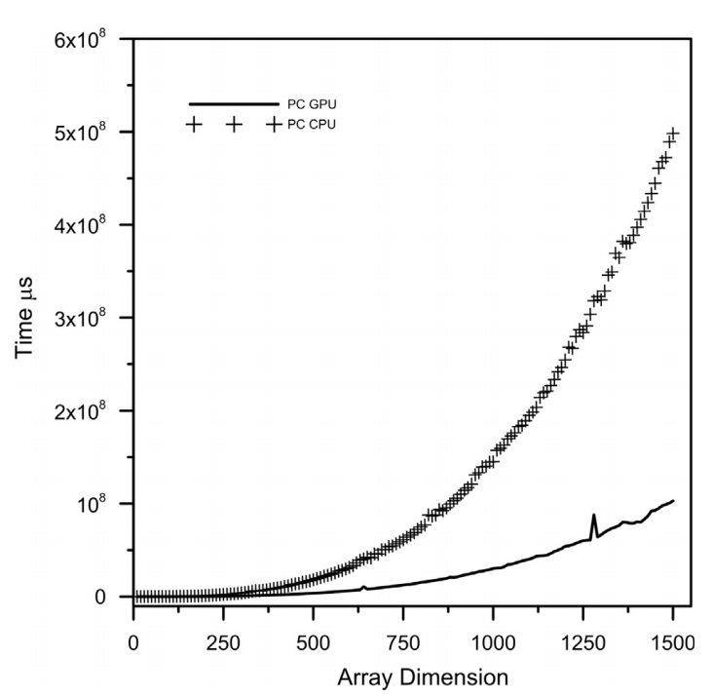
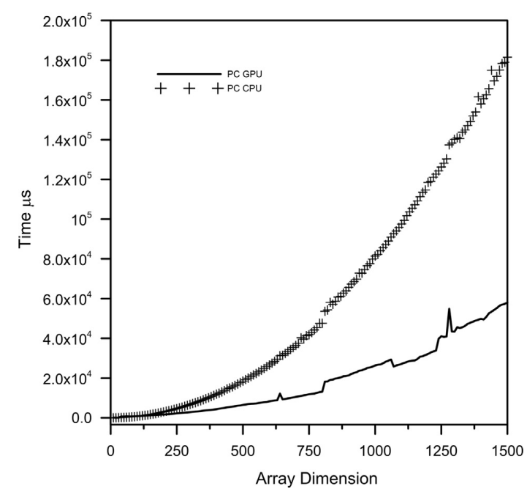
Results - Inversion and Addition
Matrix Inversion
Around dimension of 300 - 400, significant differences exist
Saved time is around 79.5% on local and 97% on server
O(n³) growth on cpu against nearly O(n² log n) growth on gpu
Matrix Addition
Saved time is around 65% - 80% due to simple operations
O(n²) against O(n log n) growth

Slide 29
Proof-Of-Concept
Instead of using CUBLAS built-in functions, we implemented the algorithms ourselves.
Approach
Implement serial program following the matrix formulas, multiplication and Gaussian-Jordan
Implement parallel program from serial program using openMP
Implement cuda program from parallel program
Calculate number of blocks required based on input size and number of threads
Each thread handle an element in the matrices
Achieve parallelism using gpu threads and block architecture
For details, refer to source code available on repository
Implementation of CUDA inversion algorithm is inspired by Girish Sharma et. al (2013) - A Fast Parallel Gauss Jordan Algorithm for Matrix Inversion using CUDA

Slide 30
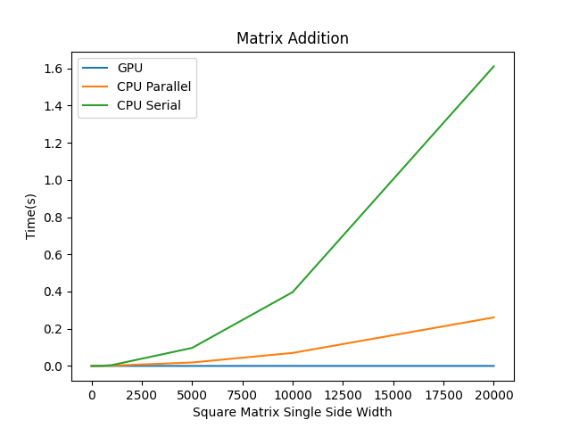
Proof-of-Concept - Matrix Addition
Size of Matrix (n x n) | Computation Time(s)
 | CPU(Serial) | CPU(Parallel) | GPU
2x2 | 0.000000 | 0.000150 | 0.000151
5x5 | 0.000000 | 0.000048 | 0.000056
10x10 | 0.000000 | 0.000072 | 0.000044
50x50 | 0.000007 | 0.000055 | 0.000044
100x100 | 0.000032 | 0.000073 | 0.000040
500x500 | 0.000988 | 0.000517 | 0.000064
1000x1000 | 0.004202 | 0.001650 | 0.000073
5000x5000 | 0.096802 | 0.018539 | 0.000072
10000x10000 | 0.396718 | 0.069949 | 0.000077
20000x20000 | 1.610584 | 0.260840 | 0.000072
1000x1000 Saved Time: (0.004202-0.000073)/0.004202 x 100% = 98.26%

Slide 31
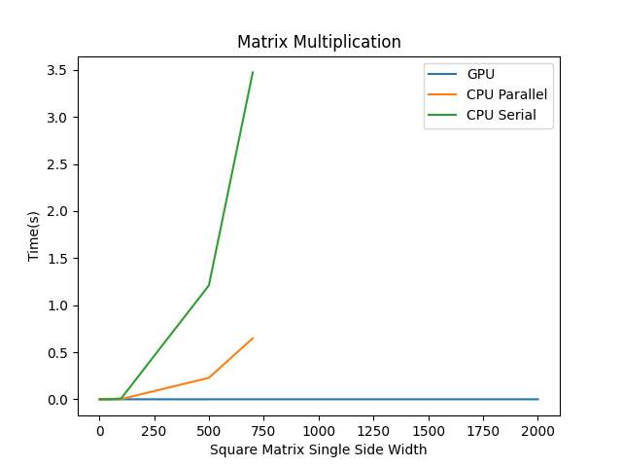
Proof-of-Concept - Matrix Multiplication
Size of Matrix (n x n) | Computation Time(s)
 | CPU(Serial) | CPU(Parallel) | GPU
2x2 | 0.000000 | 0.000094 | 0.000007
5x5 | 0.000001 | 0.000077 | 0.000004
10x10 | 0.000008 | 0.000084 | 0.000006
50x50 | 0.001064 | 0.000344 | 0.000006
100x100 | 0.009040 | 0.002323 | 0.000005
500x500 | 1.210402 | 0.228036 | 0.000020
700x700 | 3.474440 | 0.649057 | NULL
1000x1000 | NULL | NULL | 0.000037
2000x2000 | NULL | NULL | 0.000030
100X100 Saved Time :
(0.009040-0.000005)/(0.009040) X 100% = 99.94%

Slide 32
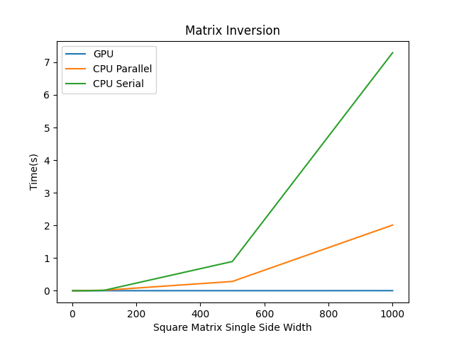
Proof-of-Concept - Matrix Inversion
Size of Matrix (n x n) | Computation Time(s)
 | CPU(Serial) | CPU(Parallel) | GPU
2x2 | 0.000000 | 0.000263 | 0.000035
5x5 | 0.000001 | 0.000566 | 0.000040
10x10 | 0.000007 | 0.001118 | 0.000046
50x50 | 0.001023 | 0.006850 | 0.000077
100x100 | 0.011141 | 0.013016 | 0.000180
500x500 | 0.894919 | 0.283505 | 0.000694
1000x1000 | 7.292919 | 2.011267 | 0.001414
500 x 500 Saved Time:
(0.894919 - 0.000694) / 0.894919 x 100% = 99.9%

Slide 33
THANK YOU

Slide 34
References
Gutiérrez de Ravé, E., Jiménez-Hornero, F. J., Ariza-Villaverde, A. B., & Gómez-López, J. M. (2014). Using general-purpose computing on Graphics Processing Units (GPGPU) to accelerate the ordinary Kriging algorithm. Computers & Geosciences, 64, 1–6. https://doi.org/10.1016/j.cageo.2013.11.004
Jia, X., Ziegenhein, P., & Jiang, S. B. (2014). GPU-based high-performance computing for radiation therapy. Physics in Medicine and Biology, 59(4). https://doi.org/10.1088/0031-9155/59/4/r151
Moore G E 1965 Cramming more components onto integrated circuits Electronics 38 114
Xiao K, Chen D Z, Hu X S and Zhou B 2012 Efficient implementation of the 3D-DDA ray traversal algorithm on GPU and its application in radiation dose calculation Med. Phys. 39 7619–25
Podlozhnyuk V 2007 Image convolution with CUDA http://developer.download.nvidia.com/compute/DevZone/C/html/C/src/convolutionSeparable/doc/convolutionSeparable.pdf
Jia X, Schuemann J, Paganetti H and Jiang S B 2012a GPU-based fast Monte Carlo dose calculation for proton therapy Phys. Med. Biol. 57 7783–97
NVIDIA CUDA Documentation. https://docs.nvidia.com/cuda/index.html
Zhou, B., Xiao, K., Chen, D. Z., & Hu, X. S. (2013). GPU-optimized volume ray tracing for massive numbers of rays in radiotherapy. ACM Transactions on Embedded Computing Systems, 13(3), 1–17. https://doi.org/10.1145/2539036.2539038
Kim, H., Joao, J., Mutlu, O., & Patt, Y. (2006). Diverge-merge processor (DMP): Dynamic predicated execution of complex control-flow graphs based on frequently executed paths. 2006 39th Annual IEEE/ACM International Symposium on Microarchitecture (MICRO'06). https://doi.org/10.1109/micro.2006.20

Slide 35
References
Li, J.,Heap,A.,2011.A review of comparative studies of spatial interpolation methods in environmental science:performance and impact factors.Ecol.Inf.6, 228–241
Kerry,K.E.,Hawick,K.A.,1998.Kriging Interpolation on High-Performance Computers Technical Report DHPC-035. Department of Computer Science,University of Adelaide,Australia
O’Sullivan, D., Unwin, D., 2002. Geographic Information Analysis.JohnWiley & Sons,Hoboken New Jersey(436pp)
Pesquer,L.,Cortes,A.,Pons,X.,2011.Parallel ordinary kriging interpolation incorporating automatic variogram fitting. Comput.Geosci.37,464–473
Tahmasebi,P.,Sahimi,M.,Mariethoz,G.,Hezarkhani,A.,2012.Accelerating geostatistical simulations using graphics processing units(GPU).Comput. Geosci. 46,51–52
Cheng, T.,2013.Accelerating universal Kriging interpolation algorithm using CUDA-enabled GPU.Comput.Geosci.54,178–183
Sharma, G., Agarwala, A., & Bhattacharya, B. (2013). A fast parallel Gauss Jordan algorithm for Matrix Inversion Using Cuda. Computers & Structures, 128, 31–37. https://doi.org/10.1016/j.compstruc.2013.06.015

